Slide 1
Chapter 8
Operations Security

Slide 2
Agenda
What is Operations Security?
Key Operational Procedures and Controls
Penetration Testing and Vulnerability Assessments
Intrusion Detection
Common Attacks and Methodology
Notes:
Operations Security is concerned with the day-to-day access and security of system resources. This means that there must be a framework in place consisting of the proper policies, standards, procedures and guidelines. The policies, etc must also be under continual review to ensure the remain up to date and relevant. By having these policies in place, and reviewing them as necessary, an organization is showing due care and due diligence. Securing a network always requires walking a fine line between ensuring users have access to the tools and resources necessary to perform their jobs, while still providing protection for the network.
One area of concern for the Operational Staff is in providing high availability. Through RAID, Clustering and redundant solutions, An organization can reduce downtime, whether the issues are a result of a malicious attack or simply a power failure.
Also, we have to consider the proper storage and disposal techniques. These are a part of normal operation procedures. Further, system hardening, configuration management and change management are responsibilities of operations as well.
Penetration testing, vulnerability assessments, and the implementation of IDS/IPS provide and additional layer of assurance on the network.

Slide 3
What is Operations Security?
Operations Security vs. Security Operations
  Per ISC2 “Operations Security is primarily concerned with the protection and control of information processing assets in centralized and distributed environments. Security Operations are primarily concerned with the daily tasks required to keep security services operating reliable and efficiently. Operations security is a quality of other services. Security operations is a service in its own right”
Activities that occur after the network is designed and implemented
Routine in Nature
Relies on proper monitoring and reporting to ensure that as threats evolve, so does the network defense
Part of due care and due diligence
Notes:
When we consider the term “operations” we normally think about the day-to-day tasks necessary to run a business. So the term Operations Security revolves around ensuring that we have policies, standards, procedures, etc in place to ensure that our normal business functions are security and that we’re providing C-I-A to the routine functions of the business.

Slide 4
The Cyber-Attack Challenge
Types of attacks aimed at any given network:
Anti-
detection
Hacking
Tools
Packet Forging/
Spoofing
Exploiting
Known
Vulnerabilities
Back
Doors
Skill Required to Hack
Stealth
Diagnostics
Self-Replicating
Code
Hijacking
Sessions
Disabling
Audits
Intruder
Skill
Password
Cracking
Password
Guessing
1980 1985 1990 1995 1998 2004…..
Notes:
In the 80s, hackers needed a triple degree in computing + flair+ perseverance to be successful. Today, a child can download very powerful tools from 2000 hacker sites and be very successful.
Know that not all tools used for attacking a network are on the Internet; therefore, administrators may not be aware of what a cracker might be throwing at their network.

Slide 5
General Information Security Principles
Separation of Privilege
Psychological Acceptability
Layered Defense
Incident Recording
Simplicity
Fail-Safe
Complete
Open Design
Notes:
General Security Principles
This list represents recommendations on how to safeguard against the attacks listed previously. An effective security program will include all of them.

Slide 6
Control Mechanisms
Control Mechanisms
  Protect information and resources from unauthorized disclosure, modification, and destruction
Main types of mechanisms
    Physical
    Administrative
    Technical
Notes:
Purpose of Access Control

Slide 7
General Control Layers
Administrative Controls
  Development of policies, standards, and procedures
  Screening personnel, security awareness training, monitoring system and network activity, and change control
Technical Controls
  Logical mechanisms that provide password and resource management, identification and authentication, and software configurations
Physical Controls
  Protecting individual systems, the network, employees, and the facility from physical damage
Notes:
Control Layers
Information owners should dictate who can access resources and how much capacity users can possess. The security administrator’s job is to make sure this happens.
Administrative, physical, and technical controls should be utilized to achieve the management’s directives.
Administrative controls include development and publication of policies, standards, procedures, and guidelines; screening of personnel; security awareness training; and monitoring of system activity and change control procedures.
Example: - Procedures indicating how servers should be installed, annual security awareness education for all employees, implementing a change control program.
Technical controls consist of logical access control mechanisms, password and resource management, identification and authentication methods, security devices, and
configuration of the network.
Example: - Anti-virus software, intrusion detection systems, locking down operating systems, encryption, firewalls.
Physical controls entail controlling individual access into the facility and different departments, locking systems and removing unnecessary floppy
or CD-ROM drives, protecting the perimeter of the facility, monitoring for intrusion, and environmental controls.
Example: - Removing floppy drives from computers, locking chassis’s, security guards monitoring the facility, air conditioning and humidity control.
The information owner is usually a senior executive within the management group of the company. The information owner has final corporate responsibility of data protection and would be the one held liable for any negligence when it comes to protecting the company’s information assets. The person that holds this role is responsible for assigning a classification to the information and dictating how the information should be protected.
If the information owner does not lay out the foundation of data protection and ensure that the directives are being enforced, this would violate the due care concept.
Note
A security control should not depend on the secrecy of its mechanisms.

Slide 8
Security Controls - Administrative
Administrative Controls
  Developing a security program
  Determining compliancy levels and consequences of non-compliance
  Indicating who has authorized access and who is unauthorized
  Classifying data and enforcing the necessary protection required for that classification
  Developing policies and standards and enforcing them when they are broken
  Developing an incident response program
  Developing a business continuity and disaster recovery plan
  Operational and continuity testing (i.e., Penetration Testing)
Notes:
Administrative Controls
Senior management must decide how security will play a role in their organization. They must determine the security goals and objectives within the organization. These directives will dictate how all the supporting mechanisms will fall into place. Basically, senior management provides the skeleton of a security infrastructure and then appoints the proper entities to fill in the rest.
The first piece to building a security foundation within an organization is a security policy. It is management’s responsibility to construct a security policy and delegate the development of the supporting procedures, standards, and guidelines; as well as to indicate which personnel controls should be used and how testing should be carried out to ensure that all pieces fulfill the company’s security goals.
These items are described as administrative controls and work at the top layer of a hierarchical access control model.

Slide 9
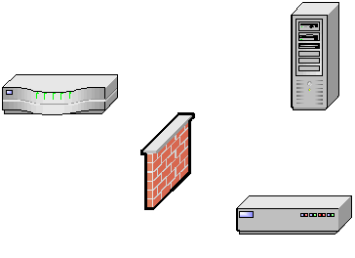
Security Controls – Technical
Technical Controls
  Implementing access control - requiring users to authenticate before accessing a system or data
  Encrypting data where it is stored and/or is transmitted
  Implementing firewalls and IDS
  Fault tolerance and load balancing
  Auditing
Notes:
Technical Controls
Logical controls, also called technical controls, are the hardware and software tools used to restrict a subject’s access to objects. They are core components of operating systems, add-on security packages, applications, network hardware devices, protocols, and access control matrixes. These controls work at different layers within a network or system and need to maintain a synergistic relationship to ensure that there is no unauthorized access to resources and that the resources’ confidentiality, integrity, and availability is guaranteed. Technical controls protect the integrity and availability of resources by limiting the number of subjects that can access them and protect the confidentiality by preventing disclosure to unauthorized subjects.

Slide 10
Security Controls – Physical
Physical Controls
  Locks and alarms on exterior doors
  Security guards watching for suspicious individuals and activities
  Intrusion detection systems to physically protect the facility
  Removing floppy drives so information cannot be copied and brought out of a building
  Storing backup data in a fire proof safe and/or at an offsite facility
Notes:
Physical Controls
It is important to understand that there are physical controls that must support and work with administrative and logical controls to supply the right degree of access control.
Physical controls include verifying individuals’ identities prior to entering a facility, erecting fences around the exterior of the facility, making sure server rooms and wiring closets are locked and protected from environmental elements (humidity, heat, and cold), and allowing only certain individuals to access work areas that contain confidential information.

Slide 11
Access Control Types
Preventative
  Controls used to prevent undesirable events from taking place
Detective
  Controls used to identify undesirable events that have occurred
Corrective
  Controls used to correct the effects of undesirable events
Deterrent
  Controls used to discourage security violations
Recovery
  Controls used to restore resources and capabilities
Compensation
  Controls used to provide alternative solutions
Notes:
Access Control Types
There are several types of security mechanisms, and they all need to work together. The complexity of the controls and of the environment they are in can cause the controls to contradict each other or leave gaps in security. This can introduce unforeseen holes in the company’s protection that are not fully understood by the implementers. Very strict technical access controls could be in place and all the necessary administrative controls could up to snuff, but if any person is allowed to physically access each and every system in the facility, then there are clear security dangers present within the environment.
Directive Controls are policies to preclude or mandate actions to reduce risk.
All controls that are administrative, technical, or physical can be easily subcategorized as either preventative, detective, or corrective.

Slide 12
Control Combinations
Preventative – Administrative
  Policies and procedures
  Pre-employment background checks
  Data classification and labeling
  Security awareness
Preventative – Physical
  Badges and swipe cards
  Guards, dogs, motion detectors, CCTV
  Fences, locks, man-traps, alarms
Preventative – Technical
  Passwords, biometrics, smart cards
  Encryption, protocols, call-back systems, database views, constrained user interface
  Anti-virus software, ACL's, firewalls, routers, clipping levels
Notes:
Control Combinations

Slide 13
Control Combinations
Detective – Administrative
  Job rotation
  Sharing responsibilities
  Inspections
  Incident response
Detective – Technical
  IDS
  Reviewing audit logs
  Reviewing violations of clipping levels
Detective – Physical
  Human evaluation of output from sensors or cameras
    Motion detectors, intrusion detection, video cameras

Slide 14
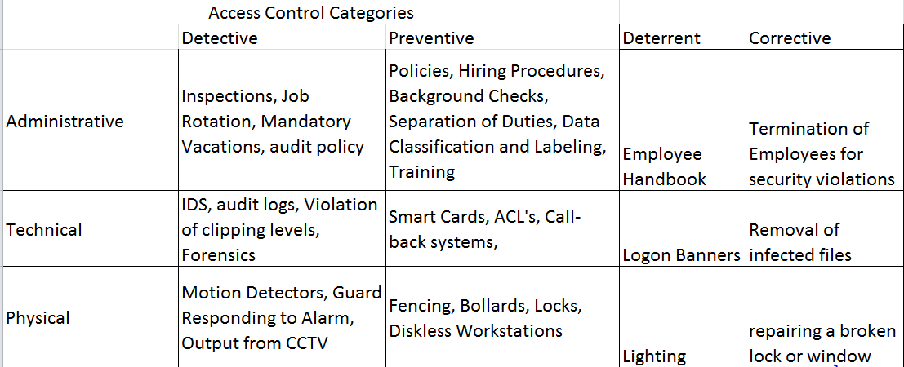
Common Combinations of Controls

Slide 15
How Controls Work Together
Administrative Controls
Physical Controls
Policies,
Standards,
Procedures,
Guidelines,
Screening,
Personnel,
Security Awareness
Technical Controls
Logical Access
Controls,
Encryption,
Security Devices,
Identification and Authentication
Facility Protection,
Security Guards,
Locks,
Monitoring,
Environmental Controls,
IDS
Physical Controls
Technical Controls
Administrative Controls
Company Data
And Assets
Notes:
How Controls Work Together
The layer approach to security is the most effective approach. Good information security practices are the result of implementing policies, standards, and procedures used to identify, control, and protect data and other assets. It encompasses all of the security controls put in place within an environment to protect information in all forms.

Slide 16
Key Operational Procedures and Controls
Fault Management
Configuration Management
System Hardening
Change Control
Trusted Recovery
Media Management
Identity and Access Management
Monitoring
Security Auditing and Reviews

Slide 17
Fault Management
Spares
Redundant Servers
UPS
Clustering
RAID
Shadowing, Remote Journaling, Electronic Vaulting
Back Ups
Redundancy of Staff
Notes:
The goal of high availability is to reduce/eliminate downtime within an organization. Though there are a variety of ways to provide availability most revolve around the idea of fault tolerance and eliminating a single point of failure.

Slide 18
Spares
Redundant hardware
Available in the event that the primary device becomes unusable
Often associated with hard drives
Hot, warm and cold swappable devices
SLAs
MTBF and MTTR
Mean time between failure = 785 days; Mean time to repair = 16 Hours
Mean time between failure =650 days; Mean time to repair = 12 Hours
Mean time between failure =652 days; Mean time to repair = 24 Hours
Notes:
Having spare components available is certainly one way to reduce the impact of a device failures. We often call the extra components “spares”. However, more commonly, when people talk about spares in reference to computing systems, they’re often speaking of hard drives, often in reference to a hardware based RAID solution. A hot swappable drive is one that is already installed in the system and ready to take over when needed. A warm swappable drive is installed, but not powered on, until there is user action. And a cold spare is available, but would need to first be installed.
Two metrics that can be used to assess the durability of a device are MTBF and MTTR. Mean Time Between Failures indicates the average lifetime of a component. Mean Time To Repair is not used today as frequently as many devices are replaced rather than repaired.

Slide 19
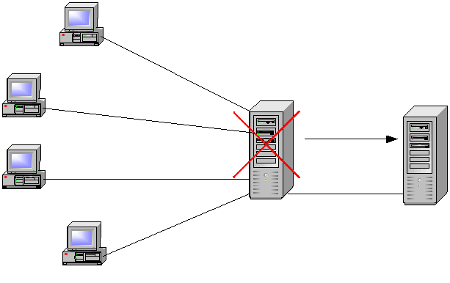
Redundant Servers
Primary server mirrors data to secondary server
  If primary fails it rolls over to secondary
  Server fault tolerance

Slide 20
Uninterruptible Power Supply
Issues to Consider
  Size of load UPS can support
  How long it can support this load (battery duration)
  Speed the UPS takes on the load when the primary power source fails
  Physical space required
Desirable Features
  Long battery life
  Remote diagnostic software
  Surge protection and line conditioning
  EMI/RFI filters to prevent data errors caused by electrical noise
  High MTBF values
  Allow for automatic shutdown of system
Notes:
Uninterruptible Power Supply

Slide 21
Clustering
Group of servers that are managed as a single system
Higher availability, greater scalability, easier to manage instead of individual systems
May provide redundancy, load balancing, or both.
  Active/Active
  Active/Passive
Cluster looks like a single server to the user
  Server farm
Notes:
Clustering
Clustering is a fault tolerant server technology that is similar to redundant servers, except each server takes part in processing services that are requested. A server cluster is a group of servers that are viewed logically as one server to users and are managed as a single logical system. Clustering provides for availability and scalability.
It groups physically different systems and combines them logically, which provides immunity to faults and improves performance. Clusters can work as an intelligent unit to balance traffic, and users that access the cluster do not know that they may be accessing different systems at different times. To the users, all servers within the cluster are seen as one unit.
If one of the systems within the cluster fails, processing continues because the rest pick up the load, although there could be degradation in performance. This is more attractive than having a secondary server that waits in the wings incase a primary server fails, because this secondary server may just sit idle for a long period of time, which is wasteful.
***the primary purpose of server clustering is redundancy. There are implementations of a clustering that do not provide load balancing, only redundancy. Also, servers can be configured in different modes: Active/Active or Active/Passive. In the Active/Active implementation load balancing is provided. In the active passive mode, one server is active and the other is offline until failover.

Slide 22
Backups
Backing up software and having backup hardware is a large part of network availability
It is important to be able to restore data:
  If a hard drive fails
  A disaster takes place
  Some type of software corruption
Notes:
Backups
A policy needs to be developed that indicates what gets backed up, how often, and how. If users have important information on their workstations, then a method needs to be worked out that indicates that backups include certain directories on users’ workstations, or that user’s move their critical data to a server share at the end of each day to ensure that it gets backed up. Backups may occur once or twice a week, every day, or every three hours. It is up to the company to determine this routine. The more frequent the backups, the more staff time will be dedicated to it, thus there needs to be a balance between backing up costs and the actual risk of potentially losing data.
A company may find that it is more economical and effective to have automatic backups done through specialized software instead of spending IT work hours towards the task. It is important to check the integrity of these backups to ensure that things are happening as expected, versus finding out right after two major servers blow up that the automatic backups were only saving temporary files.
Note
Data backups’ proper logic
o What to backup
o How to store the backup
o Where to store the back ups
o When to make back ups

Slide 23
Backups
Full backup
  Archive Bit is reset
Incremental backup
  Backs up all files that have been modified since last backup
  Archive Bit is reset
Differential backup
  Backs up all files that have been modified since last full backup
  Archive Bit is not reset
Copy backup
  Same as full backup, but Archive Bit is not reset
  Use before upgrades, or system maintenance

Slide 24
Backups
Sunday
Monday
Tuesday
Wednesday
Thursday
Backups
needed
to
recover
Full
Full
Full
Full
Full(w)
Full(s) + Inc (m,t,w)
Full
Inc
Inc
Inc
Full
Diff
Diff
Diff
Full(s) + Diff (w)
Server Crash!!!!!

Slide 25
Backup Issues
Critical data needs to be identified for backups
Media Rotation Scheme
  Grandfather, Father, Son
  Tower of Hanoi
Backup schedule needs to be developed
If restoring a backup after a compromise, ensure that the backup material does not contain the same vulnerabilities that were exploited

Slide 26
Redundancy of Staff
Eliminate Single Point of Failure
Cross Training
Job Rotation
Mandatory Vacations
Training and Education

Slide 27
Configuration Management
  Defined by ISC2 as “a process of identifying and documenting hardware components, software and the associated settings.”
  The goal is to move beyond the original design to a hardened, operationally sound configuration
  Identifying, controlling, accounting for and auditing changes made to the baseline TCB
  These changes come about as we perform system hardening tasks to secure a system.
Will control changes and test documentation through the operational life cycle of a system
Implemented hand in hand with change control
ESSENTIAL to Disaster Recovery
Notes:
Though systems often begin with a default configuration, additional controls must be added to ensure the system will function in a secure environment. The addition of these additional controls and the methods we use to secure a system are referred to as “hardening a system”. The ideal goal is to have a configuration that moves beyond the default settings into a known, trusted, hardened system with settings that can applied throughout the network. The process of creating, documenting, implementing and monitoring this configuration is referred to as configuration management.
Maintaining the proper documentation regarding system configuration is essential for many reasons. All software has vulnerabilities, and often those vulnerabilities are particular to individual vendors/versions/releases/etc. By knowing the exact configuration of systems on the network, a security administrator will be able to more effectively address the specific vulnerabilities relevant to his or her network. Second, proper documentation will help the administrator identify unauthorized hosts, when scanning the network. And finally, configuration management is essential in regards to business continuity. When trying to restore operations after a disaster, an administrator has to have a reliable source of information about the network in its previous state.

Slide 28
Configuration Management Documentation
Make
Model
MAC address
Serial number
Operating System/Firmware version
Location
BIOS or other passwords
Permanent IP if applicable
Organizational department label

Slide 29
System Hardening & Baselining
Removing Unnecessary Services
Installing the latest services packs and patches
Renaming default accounts
Changing default settings
Enabling security configurations like auditing, firewalls, updates, etc
***Don’t forget physical security!***
Notes:
Regardless of the function of a system, there are certain basic steps that can be taken to secure that system. Removing unnecessary applications and services is always the first step in hardening a system. Applications and services often have associated ports that are configured to “listen”. Essentially this provide an attacker with an entry point into the network.
Ensuring that the latest security patches and services packs are installed is another way to work towards creating a secure environment. Often software that is “buggy” is put on the market. Attackers will find these flaws and often will make these exploits public. In response, the vendor will create a security patch to shore up these weaknesses. If an administrator doesn’t keep up with the latest patches, then he or she will run the risk of leaving their systems exposed.
Further, keep in mind that systems are rarely configured with the most robust security settings out of the box. Often, ease of use and performance are the first considerations. Default settings and accounts, though useful, are well known and easy targets. Everyone knows the administrative account is often named simply “administrator” and many people may choose a very simple password, like “password”. These weak setting need to be modified. Personal firewalls, auditing and automatic updates should be enabled to provide extra protection. The security baseline details the minimum acceptable security configuration and must be followed.

Slide 30
Change Management
Directive, Administrative Control that should be incorporated into organizational policy.
The formal review of all proposed changes--no “on-the-fly” changes
Only approved changes will be implemented
The ultimate goal is system stability
Periodic reassessment of the environment to evaluate the need for upgrades/modifications
Notes:
In order to provide a stable computing environment, there must be a formal process with which to approach change. Regardless of the logic of a change, the process must be followed in all situations except emergency situations.
*****One of the hardest things for many CISSP candidates is avoiding the tendency to “fix the problem”. Instead, look for the solutions that involve doing research and obtaining management approval, then following change control procedures instead*********8

Slide 31
The Change Management Process
Request Submittal
Risk/Impact Assessment
Approval or Rejection of Change
Testing
Scheduling/User Notification/Training
Implementation
Validation
Documentation
Notes:
The process for change management should include
Request Submittal: Suggested changes should be formally submitted to a change control board or committee
Risk/Impact Assessment: The CCB is responsible for conducting a risk assessment in regard to the particular change
Approval or Rejection of Change: CCB provides formal approval or rejection of change request
Testing: Approved changes are passed to the operations department for testing in a non-production environment. The security team should provide a final review of the change
Scheduling/User Notification/Training: The change will be scheduled, the users notified and properly trained.
Implementation: the change is implemented into production and closely monitored
Validation: The operations staff ensures the change has been implemented and is providing the desired functionality
Documentation

Slide 32
Patch Management
An essential part of Configuration and Change Management
May come as a result of vendor notification or pen testing
Cve.mitre.org (Common Vulnerability and Exposures) database provides standard conventions for known vulnerabilities
Nvd.nist.gov Enables automation of vulnerability management, security measurement, and compliance. NVD includes databases of security checklists, security related software flaws, incorrect configurations, product names, and impact metrics.
www.cert.gov: Online resource concerning common vulnerabilities and attacks
Notes:
Often, when vendors release security patches or hot-fixes, they don’t necessarily provide information on which flaws these revisions were developed to address. In these instances, it is beneficial to look to a third party for additional information. The CVE, maintained by Mitre, The National Vulnerabilities Database, and Cert are all reliable resources.

Slide 33
Patch Management Definition and Scope
Faster, more systematic testing and an optimized patch rollout reduces the window of vulnerability on installed systems
Weakness Weakness Vendor Patch Central Local Patch Controlling
found published Notice created testing testing rollout weakness
Systems vulnerable to attack
Notes:
Software Patch Cycle

Slide 34
Trusted Recovery
System reboot, emergency system restart, system cold start
No compromise of protection mechanisms or possibility of bypassing them
Preparing system for failure and recovering the system
Failure of system cannot be used to breach security
Notes:
Trusted Recovery
A system reboot takes place after shutting down the system in a controlled manner in response to a trusted computer base (TCB) failure. If the system finds inconsistent object data structures, or if there is not enough space in some critical tables, a system reboot may take place. This releases resources and returns the system to a more stable and safe state.
An emergency system restart takes place after a system failure happens in an uncontrolled manner. This can be a TCB or media failure that could be caused by lower-privileged user processes attempting to access memory segments that are restricted. The system sees this as an insecure activity that it cannot properly recover from without rebooting. The system goes into a maintenance mode and recovers from the actions taken. The system is brought back up in a consistent and stable state.
A system cold start takes place when an unexpected TCB or media failure happens and the regular recovery procedure cannot recover the system to a more consistent state.
The system, TCB, and user objects may remain in an inconsistent state while the system attempts to recover itself, and intervention may be required by the user or administrator to restore the system.
It is important that the system does not enter an insecure state when it is affected by any of these types of problems and that it shuts down and recovers properly to a secure and stable state.

Slide 35
Media Managment
Production Libraries
  Holds software used in production environment
Programmer Libraries
  Holds work in progress
Source Code Libraries
  Holds source code and should be escrowed
Media Library
  Hardware centrally controlled
Notes:
Libraries
**A part of change control should include proper media management.**
Each library should be securely stored separate from one another, and code being transferred from one library to another should be tightly controlled. Code stored in all libraries should be backed up and under version control.

Slide 36
Controlling Access to Media – Librarian
Librarian to control access
Log who takes what materials out and when
Materials should be properly labeled
Media must be properly sanitized when necessary
  Zeroization (Previous DoD standards required seven wipes. Currently, only one is required.)
  Degaussing (Only good for magnetic media)
    Coercivity: Amount of energy required to reduce the magnetic field to zero
  Physical destruction (The best means of removing remnants).
Notes:
Controlling Access to Media
Many times companies have a media library with a librarian in charge of protecting its resources. Users may be required to checkout specific types of media and resources instead of having the resources readily available for anyone and everyone to access. If the library controls media holding data, each should be labeled with the following information:
Media should be clearly marked, logged, its integrity verified, and it should be properly erased of data when necessary. When media is cleared of its contents, it is said to be sanitized. There are different methods for sanitation, overwriting, degaussing and destruction.
Note
• Degaussing generates coercive magnetic force for the purpose of reducing magnetic flux density to zero on storage media
• Zeroization is the erasing of electronic data by altering contents so that data recovery is not possible
• A common security problem is discarded storage media
Library management is an example of operations security through resource protection

Slide 37
Identity and Access Management
Identity Management
  Controls the life cycle for all accounts in a system
Access Management
  Controls the assignment of rights/privileges to those accounts
Per ISC2, Identity and Access Management solutions “focus on harmonizing the provisioning of users and managing their access across multiple systems with different native access control systems”.

Slide 38
Privileged Accounts
Root/Built-in Administrator
Service accounts
Administrator Accounts
Power User Accounts
Notes:
There are four types of accounts, each with a different level of privilege
Root (or built in administrator)
All powerful built-in account for performing administrative tasks. In the past, these accounts have been shared by administrators to perform administrative tasks. However, any time an account is shared, there is a loss of accountability. Instead, administrators should each be given a unique administrative account/credentials (as seen below)
Should be renamed and given a strong passwords
Manual logs should be used in addition to the system audit log to record use of this account. The logs should be checked periodically for correlation.
Service accounts
Used to provide automated services—these services require accounts to perform actions on a system
Provide privileged access used by system services and core applications
Administrator accounts:
Assigned to specified individuals that require admin access to a system to perform maintenance activities
These individuals should acknowledge in writing their receipt of this administrative account and agree to operational policies of the organization
Should be audited by external auditing mechanisms as these accounts usually have access ot the audit logs
Power User Accounts
Often granted more privileges than standard users
More restrictive than administrative privileges
**Each of these accounts should periodically be reassessed for business need.**

Slide 39
Security Auditing and Reviews
Security Audit
  Conducted by 3rd party
  Determines the degree to which required controls are implemented
Security Review
  Conducted by system maintenance or security personnel
  Goal is determine vulnerabilities within a system. Also known as a vulnerability assessment

Slide 40
Security Reviews/Vulnerability Assessments and Penetration Testing
Vulnerability Assessment
  Physical / Administrative/ Logical
  Identify weaknesses
Penetration Testing
  Ethical hacking to validate discovered weaknesses
  Red Teams (Attack)/Blue Teams (Defend)
NIST SP 800-42 Guideline on Security Testing

Slide 41
Steps of a Pen Test
Discovery
Enumeration
Vulnerability Mapping
Exploitation
Reporting
Notes:
Discovery: Foot printing/Fingerprinting the target
Enumeration: Port scans and resource identification
Vulnerability Mapping: Identifying vulnerabilities and weakness in specific systems such as weak passwords, unpatched systems, etc
Exploitation: Trying to penetrate the vulnerabilities
Reporting: Providing management with the results of the test.

Slide 42
Degree of Knowledge
Zero Knowledge (Black Box Testing): Team has no knowledge of the target and must start with only information that is publically available. This simulates an external attack
Partial Knowledge: The team has limited knowledge of the organization
Full Knowledge: This simulates an internal attack. The team has full knowledge of network operations

Slide 43
Overt or Covert Testing?
Blind
Double Blind
Targeted
Notes:
Blind: The assessors have only publicly available knowledge. The network teams knows that testing is taking place
Double Blind: The assessors have only publicly available knowledge, but in this instance the network teams do NOT know the test is taking place. This will allow evaluation of incident response.
Targeted: External consultants work with internal staff to focus on specific systems or applications

Slide 44
Testing Guidelines
Reasons for evaluating an organization’s systems
  Risk analysis
  Certification
  Accreditation
  Security architectures
  Policy development
Develop a cohesive, well-planned, and operational security testing program
Notes:
Testing Guidelines

Slide 45
More reasons to perform testing
Responsible approach to overall security
Boost company’s position in marketplace
Why do these tests work?
  Lack of awareness
  Policies not enforced
  Procedures not followed
  Disjointed operations between departments
  Systems not patched
Notes:
Reasons for testing

Slide 46
Penetration Testing Goals
Check for unauthorized hosts connected to the organization’s network
Identify vulnerable services
Identify deviations from the allowed services defined in the organization’s security policy
Assist in the configuration of the intrusion detection system (IDS)
Collect forensics evidence
Notes:
Testing Goals

Slide 47
Penetration Testing Issues
Three basic requirements:
  Defined goal, which should be clearly documented
  Limited timeline outlined
  Approved by senior management; only management should approve this type of activity
Issue: it could disrupt productivity and systems
Overall purpose is to determine subject’s ability to withstand an attack and determine effectiveness of current security measures
Tester should determine effectiveness of safeguards and identify areas of improvement. ****TESTER SHOULD NOT BE THE ONE SUGGESTING REMEDIATION. THIS VIOLATES SEPARATION OF DUTIES*****
Notes:
Pen Testing Issues
Terminology
Τester = Who is performing the penetration test
Attacker = Works against the company, whereas the tester works to improve the company’s security
Attack = Series of activities performed by a tester with the goal of circumventing the security controls. Attack may be of physical, procedural or electrical methods
Subject = Organization that the test is being performed on
Target = System or organization that is subjected to a particular attack
Penetration Test = Performance of simulated attack on target
Tiger Team = Independent computer security experts hired to attempt to breach a system’s security.

Slide 48
Roles and Responsibilities
Approval for the tests may need to come from as high as the CIO
Customary for the testing organization to alert other security officers, management, and users
Avoid confusion and unnecessary expense
In some cases, it may be wise to alert local law enforcement officials
Notes:
Responsibilities

Slide 49
Rules of Engagement
Specific IP addresses/ranges to be tested
  Any restricted hosts
A list of acceptable testing techniques
Times when testing is to be conducted
Points of contact for the penetration testing team, the targeted systems, and the networks
Measures to prevent law enforcement being called with false alarms
Handling of information collected by penetration testing team
Notes:
Rules of Engagement

Slide 50
Types of Penetration Tests
Physical Security
  Access into building or department
  Wiring closets, locked file cabinets, offices, server room, sensitive areas
  Remove materials from building
Administrative Security
  Help desk giving out sensitive information, data on disposed disks
Logical Security
  Attacks on systems, networks, communication
Notes:
Types of Penetration Tests
Depending on the scope of the job, the test may use some or all of these tactics.

Slide 51
Approaches to Testing
Do not rely on single method of attack
  Get creative
Path of least resistance
  Easiest route to valuable data, maybe not through the firewall but hanging modem
Break the rules
  Even if a company follows its own policy, standards and procedures, it does not mean that there are not vulnerabilities
  Attempt things not expected
Notes:
Testing Techniques

Slide 52
Approaches to Testing
Do not rely exclusively on high-tech tools
  Dumpster diving
Stealth methods may be required
Do not damage systems or data
Do not overlook small weakness in search for the big ones
Have a toolkit of techniques

Slide 53
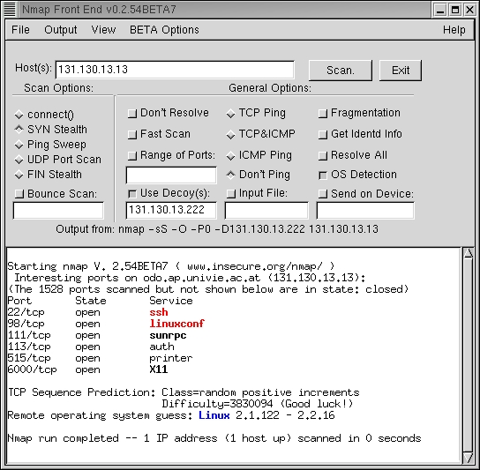
Network Scanning
List of all active hosts
Network services:
  ICMP
  UDP & TCP
Port scanner:
  Nmap
  Finger Printing
  Banner Grabbing
Notes:
Network Scanning

Slide 54
Vulnerability Scanning
Identifying:
  Active hosts on network
  Active and vulnerable services (ports) on hosts
  Applications
  Operating systems
  Vulnerabilities associated with discovered OS & applications
  Misconfigured settings
Testing compliance with host application usage/security policies
Establishing a foundation for penetration testing
Notes:
Vulnerability Scanning

Slide 55
Password Cracking
Goal is to identify weak passwords
Passwords are generally stored and transmitted in an encrypted form called a hash
Password cracking requires captured password hashes
  Hashes can be intercepted
  Can be retrieved from the targeted system
Notes:
Password Cracking

Slide 56
Password Cracking Techniques
Dictionary attack
Brute force
Hybrid attack
LanMan password hashes
Theoretically all passwords are “crackable”
  Rainbow tables

Slide 57
Rogue Infrastructures
Unauthorized DHCP Servers can be used to redirect hosts to rogue DNS servers
Rogue DNS Servers can direct traffic to spoofed hosts
DNS zone transfer information contains MUCH information about a network and its configuration
Secure physical access to the network, require DHCP servers to require authorization, User DHCP reservations and MAC addressing to control assignment of IPs, Secure DNS zone transfers only to specific hosts

Slide 58
War Dialing
Goal is to discover unauthorized modems
  Provide a means to bypass most or all of the security measures in place
Dial large blocks of phone numbers in search of available modems
  Should be conducted at least annually
  Should be performed after-hours
Include all numbers that belong to an organization, except those that could be impacted negatively
If removal is not possible, block inbound calls to the modem
Notes:
War Dialing

Slide 59
Wireless LAN Testing
802.11
  Serious flaws in its current implementation of WEP
  Lack of Authentication
  Default configuration
Web sites publish the locations of discovered wireless networks
Wireless Attacks:
  Insertion attacks
  Interception and monitoring of wireless traffic
  Denial of service
  Client to client attacks
Notes:
Wireless LAN Testing

Slide 60
Reporting
Planning
  Rules of engagement
  Test plans
  Written permission
Discovery and Attack
  Documentation of logs
  Periodic reports
End of test overall report
  Describe the identified vulnerabilities and risk rating
  Remember, the Pen Tester does NOT provide mitigation advice. They simply provide a report on weaknesses found
Notes:
Reporting

Slide 61
Corrective Actions – 1 of 2
Investigate and disconnect unauthorized hosts
Disable or remove unnecessary and vulnerable services
Modify vulnerable hosts to restrict access to vulnerable services to a limited number of required hosts
  (i.e., host-level firewall or TCP wrappers)
Modify enterprise firewalls to restrict outside access to known vulnerable services
  Ingress Filtering: No inbound traffic allowed with internal addresses (spoofing)
  Egress Filtering : No outbound traffic allowed with external addressing (DDoS)
Notes:
Corrective Actions

Slide 62
Corrective Actions – 2 of 2
Upgrade or patch vulnerable systems
Deploy mitigating countermeasures
Improve configuration management program and procedures
Assign a staff member to:
  Monitor vulnerability alerts/mailing lists
  Examine applicability to environment
  Initiate appropriate system changes
Modify the organization's security policies and architecture
All of the above require going through proper change management procedures

Slide 63
Log Reviews
Firewall logs
IDS logs
Server logs
Other logs that are collecting audit data
Snort is a free IDS sensor
Log Reviews should be conducted very frequently on major servers and firewalls
Notes:
Log Reviews

Slide 64
Deploy File Integrity Checkers
Computes and stores a checksum
Should be recomputed regularly
Usually included with any commercial host-based intrusion detection system
Requires a system that is known to be secure to create the initial reference database
False positive alarms
LANguard is a freeware file integrity checker
Notes:
File Integrity Checkers

Slide 65
Watching Network Traffic
Traffic Analysis—Side Channel Analysis
  Watching traffic and its patterns to try and determine if something special is taking place. For example:
    A lot of traffic between two military units may indicate that an attack is being planned
    Traffic between human resources and headquarters may indicate layoffs are around the corner
Traffic Padding
  Generating spurious data in traffic to make traffic analysis more difficult
    Sending out decoy attacks
  The amount and nature of traffic may be masked
  Attempt to keep traffic constant so no information can be gained
Notes:
Traffic Analysis

Slide 66
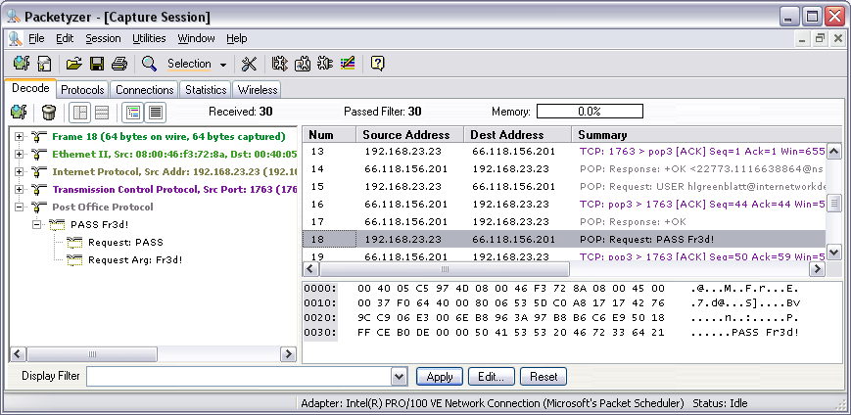
Protocol Analyzers (Sniffers) and Privacy
Promiscuous mode
Bridging / Switching can affect the Packet Capture
Notes:
Protocol Analyzers

Slide 67
Deploy Virus Detectors
Malicious code detection
Two primary types:
  Network infrastructure
  End-user machines
Update the list of virus signatures
More sophisticated programs also look for virus-like activity in an attempt to identify new or mutated viruses
Notes:
Deploy Virus Detectors

Slide 68
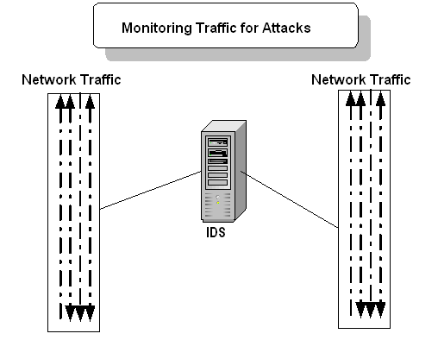
Intrusion Detection Systems
Software is used to monitor a network segment or an individual computer
Used to detect attacks and other malicious activity
Dynamic in nature
The two main types:
  Network-based
  Host-based systems (TCP Wrappers)
Notes:
IDS
IDS can be configured to watch for attacks, parse audit logs, alert an administrator as attacks are happening, protect system files, expose a hacker’s techniques, illustrate which vulnerabilities need to be addressed, and possibly help to track down individual hackers.
Host-based IDS can be installed on individual workstations and/or servers and watch for inappropriate or anomalous activity and insider attacks. Host-based IDS’s are usually used to make sure users do not accidentally delete system files, reconfigure important settings, or put the system at risk in any other way. Network-based IDS’s monitor network traffic and uncover possible attacks or suspicious activities. This is usually done by anomaly detection and pattern detection.
Note
• A type of host-based IDS used on UNIX systems to protect file system integrity is Tripwire
• IDS is a detective control
• Target monitoring looks for modification of specified files. It can detect unauthorized actions by running hashes on critical files

Slide 69
Types of IDS
Network-based IDS
  Monitors traffic on a network segment
  Computer or network appliance with NIC in promiscuous mode
  Sensors communicate with a central management console
Host-based IDS
  Small agent programs that reside on individual computer
  Detects suspicious activity on one system, not a network segment
IDS Components:
  Sensors
  Analysis engine
  Management console
Notes:
An IDS can detect scanning, denial of service, and penetration attacks, but not spoofing attacks

Slide 70
IDS Componenets
IDS Components:
  Sensors
  Analysis engine
  Management console

Slide 71
Sensor Placement
In front of firewalls to discover attacks being launched
Behind firewalls to find out about intruders who have gotten through
On the internal network to detect internal attacks
Notes:
Sensor Placement
Network-based IDS’s use sensors for monitoring purposes. A sensor is placed on the network segment, and it is responsible for monitoring. This sensor works as an agent and sends data back to a monitoring console for further analysis. The monitoring console monitors all sensors and supplies the network staff with an overview of the activities of all of the sensors in the network.
These are the components that enable network-based intrusion detection to actually work. Sensor placement is a critical part of configuring an effective IDS. An organization can place a sensor outside of the firewall to detect attacks and inside the firewall (in the perimeter network) to detect actual intrusions. Sensors should also be placed in highly sensitive areas, on networks with many transient employees, and on extranets.
If the network traffic volume exceeds the IDS system’s threshold, attacks can go unnoticed. Each vendor’s IDS system product has its own threshold, and that should be known and understood before it is purchased and implemented.
In very high-traffic environments, multiple sensors should be in place so that no packet can pass without being investigated. If it is necessary for optimizing network bandwidth and speed, different sensors can be set up to analyze each packet for different signatures. This way, the analysis load can be broken up over different points.
Note
• The core piece of an IDS system is the processing engine. It sorts data, identifies intrusion indications, mines databases for attack signatures and makes decisions about thresholds for alerts and initiation responses
• Some IDS products can interact with firewalls by reconfiguring its ACL’s to block an identified attack going on

Slide 72
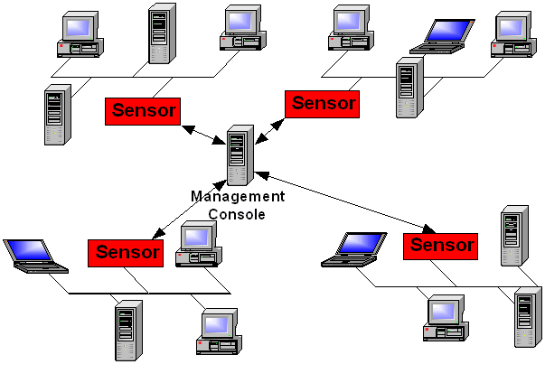
Sensor Placement

Slide 73
Analysis Engine Methods
Pattern Matching
  Rule-Based Intrusion Detection
  Signature-Based Intrusion Detection
  Knowledge-Based Intrusion Detection
Profile Comparison
  Statistical-Based Intrusion Detection
  Anomaly-Based Intrusion Detection
  Behavior-Based Intrusion Detection
Notes:
Several types of analysis engines exist for both NIDS and HIDS, such as Rule-Based, Statistical-Based, Signature Based, and Anomaly-Based. In some systems, the analysis methods are combined to provide higher levels of security.
The first method we will discuss is the Rule Based IDS.

Slide 74
Types of IDS
Signature-based—MOST COMMON
  IDS has a database of signatures, which are patterns of previously identified attacks
  Cannot identify new attacks
  Database needs continual updates
Behavior-based
  Compares audit files, logs, and network behavior, and develops and maintains profiles of normal behavior
  Better defense against new attacks
  Creates many false positives
Notes:
Types of IDS
Knowledge is accumulated about specific attacks and how they are carried out. Models of how the attacks are carried out are developed and called signatures. Each identified attack has a signature, which is used to detect an attack in progress or if one has occurred within the network. Any action that is not recognized as an attack is considered acceptable. The effectiveness of this type of protection depends on the regularity of updating the software with new signatures or known attacks. This type of IDS is weak against new types of attacks because it can only recognize the ones that have been previously identified.
This type of software observes and detects deviation from expected behavior of users and systems. A reference model of normal behavior is compiled, and future activities are compared against it. This type of IDS can use expert system technology, which attempts to think like a human expert and provide the same type of reasoning.
It can detect real time anomalies by detecting deviations from sequential rules, and it can review audit log files to detect suspicious activity that has already taken place. For an IDS to be able to perform real time anomaly detection, it uses a time-based induction machine (TIM). This is a virtual machine that tracks and builds behavior profiles for system usage, network traffic, and user activities. The profile is made up of sequences of events to be used to try and determine when something out of the ordinary happens. The behavior-based, or statistical, IDS can detect new, unforeseen vulnerabilities, but it can also cause many false alarms.
Once an attack is discovered, there are several things that can take place. This is up to the capabilities of the IDS and the policy that has been assigned to it. The IDS can send an alert to a console to tell the right individuals that an attack is being carried out, it can send an e-mail to the individual who has been delegated to respond to such activities, it can kill the connection of the detected attack, or it can reconfigure a router or firewall to try and stop any further similar attacks.
Note
•Ping sweeps, port scans, and sniffing usually take place right before an attack

Slide 75
IDS Response Options
Passive:
  Page or e-mail administrator
  Log event
Active
  Send reset packets to the attacker’s connections
  Change a firewall or router ACL to block an IP address or range
  Reconfigure router or firewall to block protocol being used for attack
Notes:
IDS Response

Slide 76
IDS Issues
May not be able to process all packets on large networks
  Missed packets may contain actual attacks
  IDS vendors are moving more and more to hardware-based systems
Cannot analyze encrypted data
Switch-based networks make it harder to pick up all packets
A lot of false alarms
Not an answer to all prayers
  firewalls, anti-virus software, policies, and other security controls are still important
Notes:
IDS Issues

Slide 77
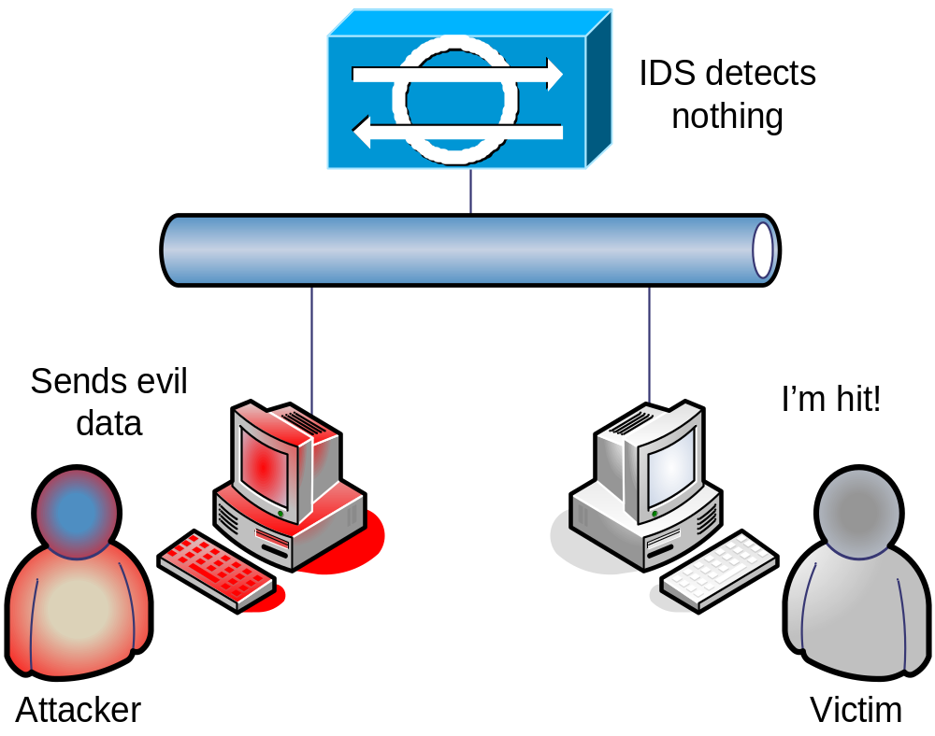
Eluding IDS – Evasion Attack
Notes:
An evasion attack is one in which an IDS rejects or doesn’t recognize a malicious packet but the host computer accepts it. Since an IDS has rejected it, it does not check the contents of the packet. Hence, using this technique, an attacker can exploit the host computer.
For example, an attacker using the Unicode character could encode attack packets that an IDS would not recognize but that an IIS web server would decode and become attacked. Polymorphic code is another means to circumvent signature-based IDSs by creating unique attack patterns, so that the attack does not have a single detectable signature. Attacks on encrypted protocols such as HTTPS are obfuscated if the attack is encrypted. Another basic technique is to split the attack payload into multiple small packets, so that the IDS must reassemble the packet stream to detect the attack.

Slide 78
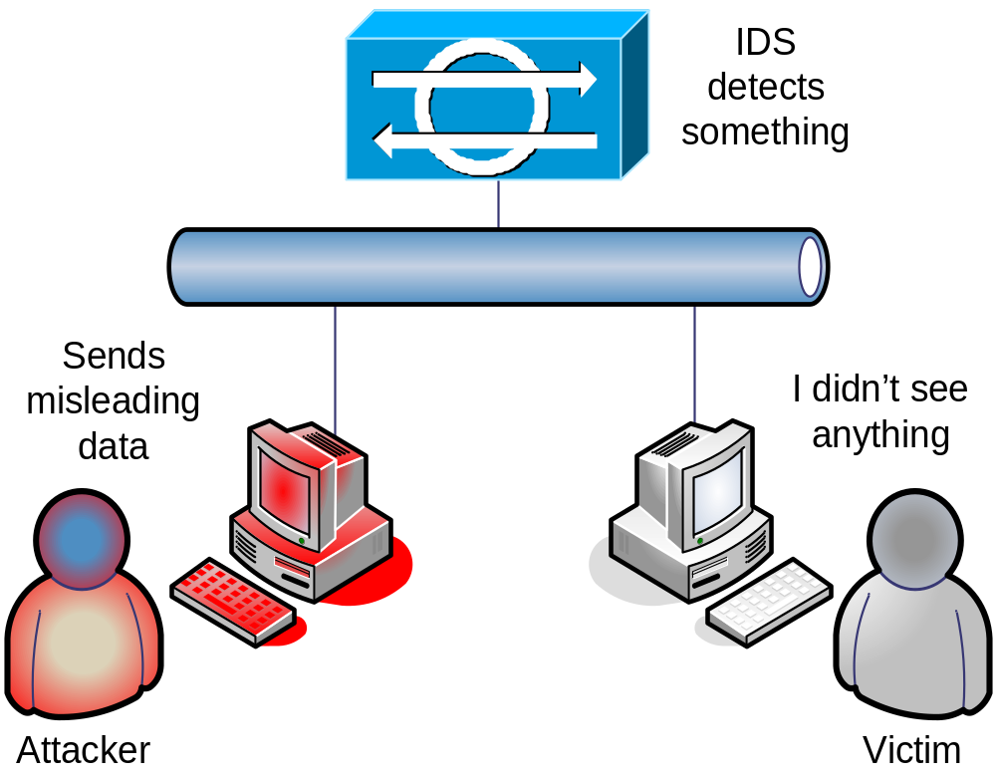
Eluding IDS – Insertion Attack
Notes:
An IDS can accept a packet that an end-system rejects. An IDS that does this makes the mistake of believing that the end-system has accepted and processed the packet when it actually hasn't. An attacker can exploit this condition by sending packets to an end-system that it will reject, but that the IDS will think are valid. In doing this, the attacker is ``inserting'' data into the IDS --- no other system on the network cares about the bad packets. An attacker can use insertion attacks to defeat signature analysis, allowing him/her to slip attacks past an IDS. This is an attack on the IDS that exploits vulnerabilities in the IDS. Such attacks can badly infect IDS signatures and IDS signature analysis.

Slide 79
Honeypot
Deployment:
  Pseudo Flaw: Loophole purposely added to operating system or application to trap intruders
  Sacrificial lamb system on the network
  Administrators hope that intruders will attack this system instead of their production systems
  It is enticing because many ports are open and services are running
Be careful of Enticement vs. Entrapment
Notes:
Honeypot
A honeypot is a computer set up as a sacrificial lamb on the network. The system is not locked down and has open ports and services enabled. This is to entice a would-be attacker to this computer instead of attacking authentic computers on a network. The honeypot contains no real company information and thus will not be at risk if and when it is attacked. This enables the administrator to know when certain types of attacks are happening and allows the administrator to fortify the environment and perhaps track down the attacker. The longer the hacker stays at the honeypot, the more will be disclosed about their techniques.
It is important to draw a line between enticement and entrapment when implementing a honeypot system. There are legal and liability issues around each. If the system only had open ports and services an attacker might want to take advantage of, this would be an example of enticement. If the system had a Web page indicating that the user can download files, and once the user does this, the administrator charges this user with hacking, this would be entrapment. Entrapment is illegal and cannot be used when charging an individual with hacking or unauthorized activity.

Slide 80
Padded Cell and Vulnerability Tools
Concept used in software programming where a “safe” environment is created for applications and processes to run in
  Similar to a virtual machine
Concept used in IDS where identified intruder is moved to a “safe” environment without their knowing
Simulated environment to keep the intruder happy and busy
  Hopefully leave production systems alone
aka: Self Mutating Honeypot, Tarpit
Notes:
Padded Cell
Ensure that when using a honeypot or padded cell that laws are not being broken. The tools should be used to entice intruders, not entrap them.

Slide 81
Email Vulnerabilities
  Protocol Weaknesses
    Relays
  Social Engineering
    Phishing
    Spoofing
    Spam
      White listing
      Black listing

Slide 82
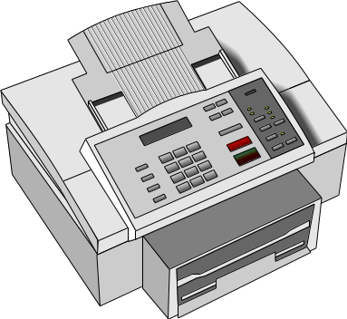
Fax Vulnerabilities
Fax Machine Security Issues
  Can be used to transfer sensitive data
  Paper sitting in bin for all to see
Solution: Fax Servers
  Fax server can route faxes to e-mail boxes instead of printing
  Can disable print feature
  Fax encryptor encrypts bulk data at data link layer
  Provides extensive logging and auditing
  Can use public key cryptography for secure transfer of material
Notes:
Facsimile Security
Fax machines can present some security issues if they are being used to transmit sensitive or confidential information. The information has to be scanned into the device, which is then transmitted over a phone line and printed out on the destination fax machine. Many times, the received fax just sits in a bin until the recipient walks over to retrieve it. If it contains confidential information, it might not be a good idea to have it just lying around for anyone to view it.
Some companies use fax servers, which are systems that manage incoming and outgoing faxed documents. When a fax is received by the fax server, it properly routes it to the individual it is addressed to so that it is not actually printed out, but held in an electronic form. Many times the received fax is routed to the recipient’s electronic mailbox.
The fax server allows many users to transmit documents from their computers to the fax server without having to pass the document through a scanner of a fax device. This reduces the amount of sensitive documentation that needs to be properly destroyed and can save money on printing and thermal paper required by stand alone fax machines.
A fax server usually has the capability of allowing someone to print the received faxes, but this can present the same security breaches of a stand alone fax device. In these cases, the print feature should be disabled so that sensitive documents can be stored and viewed only by authorized individuals.
Extensive logging and auditing is available for fax servers and should be enabled and monitored in companies that require this level of security. Since data will be traveling to and from the fax server in a clear text form, some companies may wish to implement encryption for faxed materials. Fax encryptor or a bulk data link encryption mechanism may be put into place. A data link encryption mechanism will encrypt any and all data that hits the network cable or telephone wire. This would be put into place if a company does not want to have to depend on each individual user to encrypt documents that they fax; instead, the company is ensured that all data leaving that system will be properly encrypted.

Slide 83
Denial of Service and Distributed Denial of Service
Dos Denial of Service: The purpose of these attacks is to overwhelm a system’s resources and disrupt its availability
DDoS Distributed Denial of Service: Characterized by the use of Control Machines (Handlers) and Zombies (Bots) An attacker uploads software to the control machines, which in turn commandeer unsuspecting machines to perform an attack on the victim. The idea is that if one machine initiating a denial of service attack is powerful, then having many machines perform the attack is better.

Slide 84
Types of DoS and DDoS & Countermeasures
Ping of Death-- Layer 3 attack—block ICMP at the firewall
Ping Flooding --Layer 3 attack—block ICMP at the firewall
Tear Drop—Install patches/updates, disallow malformed fragments, use a router that combines all fragments into a full packet prior to routing the packet to its destination
Buffer Overflow—Keeping systems updated, input validation, bounds checking
Bonk-- Drop—Install patches/updates, disallow malformed fragments, use a router that combines all fragments into a full packet prior to routing the packet to its destination
Land Attack—Keep system patched/updated
Notes:
Ping of Death: Sending a Ping Packet that violates the Maximum Transmission Unit (MTU) size—a very large ping packet.
Ping Flooding: Overwhelming a system with a multitude of pings
Tear Drop: Sending Malformed packets which the Operating System does not know how to reassemble
Buffer Overflow: Attacks that overwhelm a specific type of memory on a system—the buffers. Is best avoided with input validation
Bonk : Similar to the Teardrop attack. Manipulates how a PC reassembles a packet and allows it to accept a packet much too large.
Land Attack: Creates a “circular reference” on a machine. Sends a packet where source and destination are the same.
Syn Flood: Type of attack that exploits the three way handshake of TCP
Smurf: Uses an ICMP directed broadcast
Fraggle: Similar to Smurf, but uses UDP instead of ICMP

Slide 85
Types of DoS and DDoS & Countermeasures Continued
Syn Flood—Layer 4 attack. Decrease the connection-established timeout period, increaste the size of the connection queue in the IP stack, Keep system updated and patched. Install a network-based IDS, Use a firewall
Smurf: Layer 3 attack—disable direct broadcasts on border routers. Configure ingress filtering to reject any external packets with internal IP addresses (spoofed packets), use a network-based IDS
Fraggle : Layer 4 attack--disable direct broadcasts on border routers. Configure ingress filtering to reject any external packets with internal IP addresses (spoofed packets), use a network-based IDS
Notes:
Ping of Death: Sending a Ping Packet that violates the Maximum Transmission Unit (MTU) size—a very large ping packet.
Ping Flooding: Overwhelming a system with a multitude of pings
Tear Drop: Sending Malformed packets which the Operating System does not know how to reassemble
Buffer Overflow: Attacks that overwhelm a specific type of memory on a system—the buffers. Is best avoided with input validation
Bonk : Similar to the Teardrop attack. Manipulates how a PC reassembles a packet and allows it to accept a packet much too large.
Land Attack: Creates a “circular reference” on a machine. Sends a packet where source and destination are the same.
Syn Flood: Type of attack that exploits the three way handshake of TCP
Smurf: Uses an ICMP directed broadcast
Fraggle: Similar to Smurf, but uses UDP instead of ICMP

Slide 86
Other Types of Attacks & Countermeasures
Salami—Administrative controls like SoD, Mandatory vactions, Authorization limits can help prevent
Data Diddling--Administrative controls like SoD, Mandatory vactions, Authorization limits can help prevent
Covert Channels: Are best addressed at the design and architecture phases, rather than after the fact. Steganography is an example of a covert channel
  Storage
  Timing
  Asynchronous Attacks: Attacks that manipulate timing of events. Can be avoided if the operating system “locks” files while checking tasks. Good programming practices, source code scanners, and application security testing.
    TOC/TOU
    Race Conditions
Replay Attacks: Time stamping or uniqueness information on each packet is a way of circumventing replay attacks. Also, one time passwords. Encryption offers NO defense against this type of attack.
Notes:
Salami Attacks: Stealing a little bit at a time in the hopes of being “Under the Radar”. For instance, zeroing out an account balance a little at a time. Often takes place in accounting departments with the hope of going undetected.
Data Diddling: Manipulating data before input
Covert Channels: A process communicates with another process in a way which was not intended
Storage: information is stored in an unintended location
Timing: Modulation of resources is used for communication
Asynchrounous Attacks:
TOC/TOU: Creating a variance between when information is validated and when it’s used
Race Conditions: Any condition in which the attacker manipulates the order of a sequence. For example if the steps are
Identify
Authenticate
Authorize
If the attacker can quickly manipulate the series so that step 3 happens before step 3 he can gain access.
Replay Attacks: Capturing data on the network to use again later.

Slide 87
Other Types of Attacks & Countermeasures Continued
Virus--Up to date anti-virus/anti-malware
Worm--Up to date anti-virus/anti-malware
Logic Bomb—Proper administrative controls and account supervision.
Trojan Horse—Host based IDS configured to watch for changes in file size can indicate that a file is infected with a trojan
  RATs (Remote Access Trojans) allow intruders to gain access and access a system remotely
Notes:
Virus: A piece of malicious code that can take many forms and serve many purposes. Needs a host in which to live, and an action by the user to spread.
Worm: Similar to a virus, but does not need a host and is self replicating
Logic Bomb: A type of malicious code that lays dormant until a logical event occurs
Trojan Horse: One program (usually some type of malicious code) masquerades as another. Common means of distributing Back Door Programs

Slide 88
Other Types of Attacks & Countermeasures Continued
Back Door/Trap Door—Up to date anti-virus/anti-malware, host based IDS
Spoofing—Strong Authentication means
Masquerading—Strong Authentication and Awareness training
Poisoning—Checking for unsolicited replies, Using static entries instead of dynamic
Emanation Analysis—EMSEC/TEMPEST
  White Noise
  Control Zones
  Faraday Cages
Notes:
Back Door: Allows access to an application or a system while bypassing normal access control means. One common implementation is when accounts are hidden within an application without the administrator's knowledge. This was an issue with Oracle 2003.
Maintenance Hooks: allow a developer to view and edit code without having to go through regular access control. Must be removed before code goes into production
Spoofing: Impersonation, Usually technical. IP, MAC, DNS, Web Spoofing are just a few examples
Masquerading: Impersonation, usually social
Poisoning: Manipulating the cache of a system. ARP and DNS poisoning are common examples
Emanation Analysis: All electronic equipment emits a degree of radiation. With the proper equipment this radiation can be analyzed and even information can be compromised.

Slide 89
Attack Methodology
Test Attacks 1 of 2
  Reconnaissance
  WhoIs Database, Company Website, Job Search Engines, Social Networking
  2. Footprinting
    Mapping the network (Nmap)
    ICMP ping sweeps
    DNS zone transfers
  3. Fingerprinting
    Identifying host information
    Port scanning
  4. Vulnerability assessment
    Identifying weaknesses in system configurations
    Discovering unpatched software
Notes:
Test Attack Phases

Slide 90
Attack Methodology Continued
Test Attacks 2 of 2
  5. The “attack”
    Penetration
    Privilege escalation
      Run As, SU
    Root kits
      Colllection of tools to allow continued access. Includes
        Back Door software
        Can update the kernel of the operating system
        Very difficult to detect
    Cover tracks
      Trojaned Programs: The Attacker replaces default utilities with ones that masquerade as system utilities that provide normal services, with the exception of helping identifiy the backdoor software
      Log Scrubbers
Notes:
Counter measures to rootkits include properly hardening the system and ensuring anti-virus/anti malware utilities are up to date. Host-based IDS, sometimes referred to as TCP wrappers can also be used to detect roootkits.

Slide 91
Agenda Review
What is Operations Security?
Key Operational Procedures and Controls
Penetration Testing and Vulnerability Assessments
Intrusion Detection
Common Attacks and Methodology
Notes:
Operations Security is concerned with the day-to-day access and security of system resources. This means that there must be a framework in place consisting of the proper policies, standards, procedures and guidelines. The policies, etc must also be under continual review to ensure the remain up to date and relevant. By having these policies in place, and reviewing them as necessary, an organization is showing due care and due diligence. Securing a network always requires walking a fine line between ensuring users have access to the tools and resources necessary to perform their jobs, while still providing protection for the network.
One area of concern for the Operational Staff is in providing high availability. Through RAID, Clustering and redundant solutions, An organization can reduce downtime, whether the issues are a result of a malicious attack or simply a power failure.
Also, we have to consider the proper storage and disposal techniques. These are a part of normal operation procedures. Further, system hardening, configuration management and change management are responsibilities of operations as well.
Penetration testing, vulnerability assessments, and the implementation of IDS/IPS provide and additional layer of assurance on the network.

